Slide 1




DNS Cache Poisoning
Protection
Presented by: Abdallah Mohammed Hegazy 2205228
Ziad Mahmmoud Abdeljwad 2205024

Slide 2

01
02
03
Introducion
Data Exploring
preprocessing
OVERVIEW
04
05
06
Handling imbalance
Data Modeling
Results

Slide 3
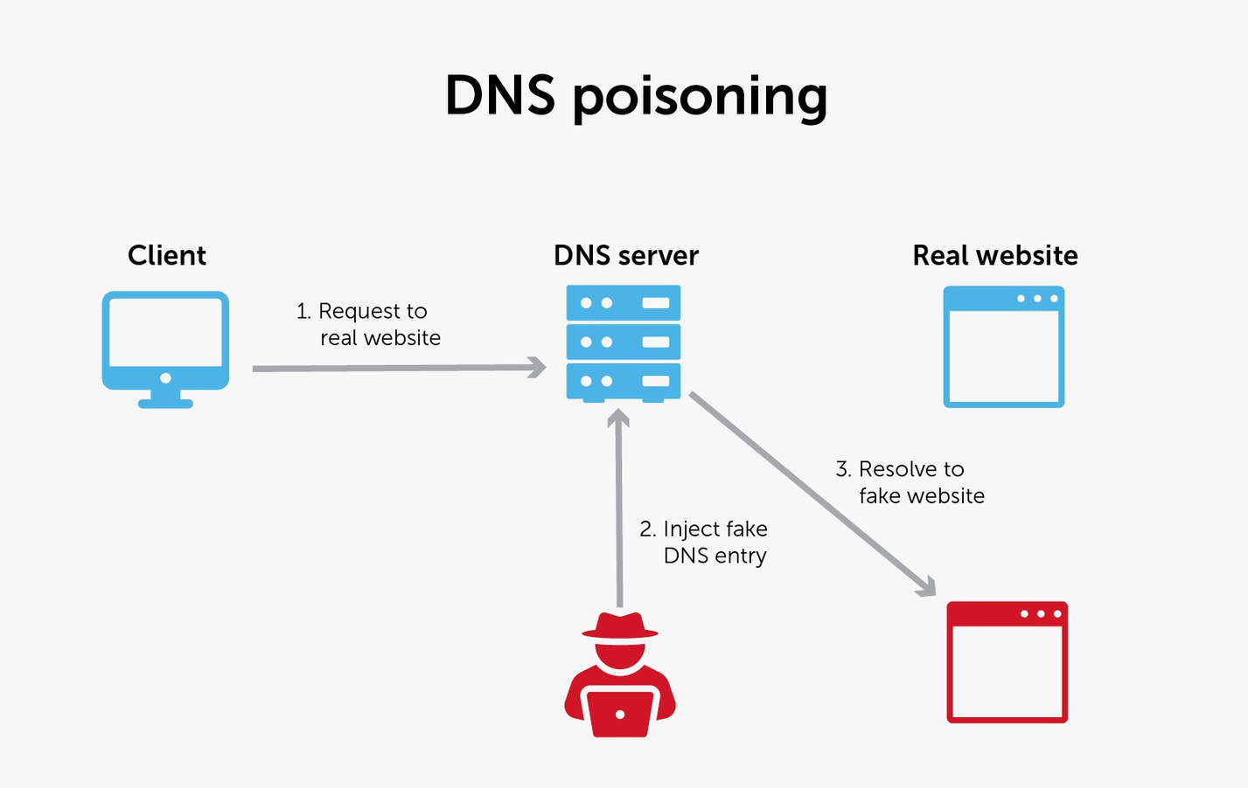


01
Introduction
DNS Cache Poisoning
is an attack that attacker try to spoof a DNS resolver's cache and inject malicious DNS information that redirecting the user to a fraudulant website.

Slide 4
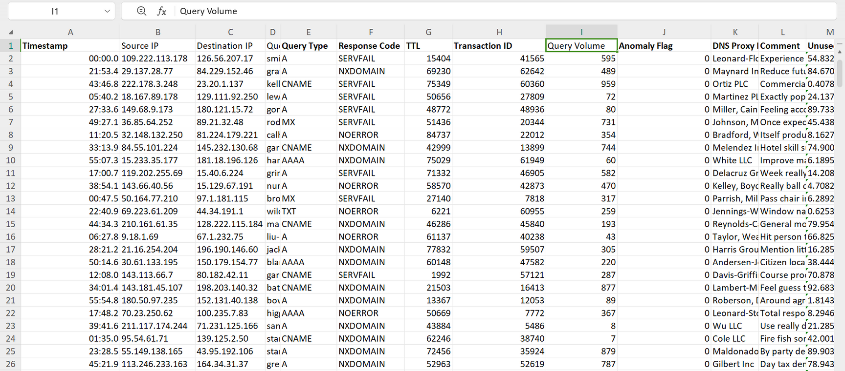
02
Explore Data
Our dataset consists of
10000 entities
16 feature

Slide 5
03
Preprocessing
Features Engineering
we perform feature engineering to determine which feature affects the accuracy of the model by calculating the entropy of each feature
Drop useless features
In our dataset there are a lot of useless features that don’t affect the model at all

Slide 6
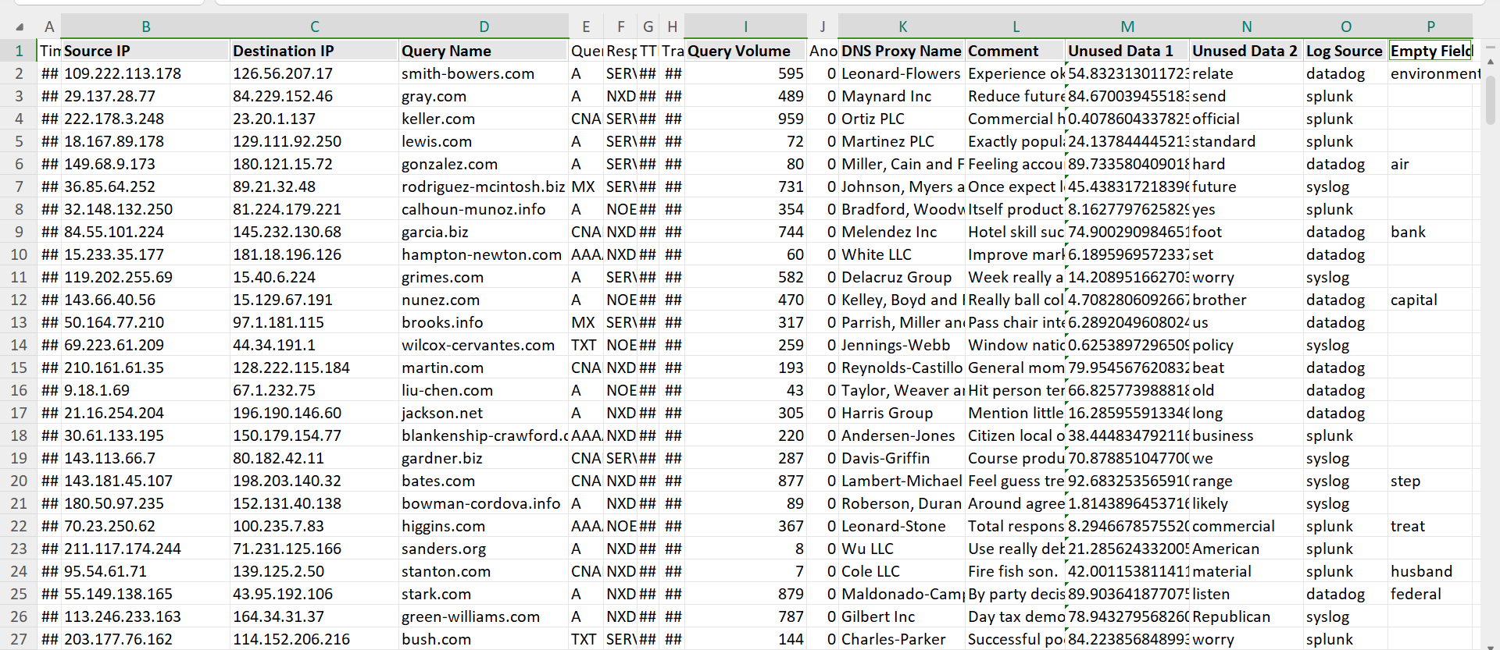

Slide 7
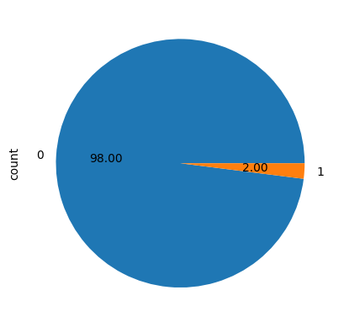
03
Preprocessing
Data is imbalanced
98% of our dataset are normal packet and only 2% of it are malicious ones.
can lead to overfitting

Slide 8
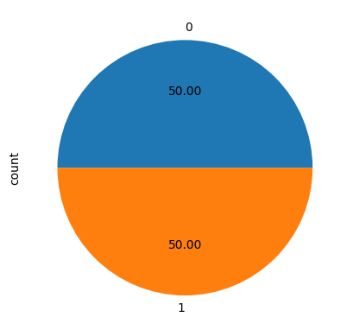
04
Handle imbalance data
To handle imbalanced data we use SMOTE function to handle imbalance data by increase the minority class to be equelivant to the other class

Slide 9
04
Handle imbalance data
To handle imbalanced data we use SMOTE function to handle imbalance data by increase the minority class to be equelivant to the other class

Slide 10
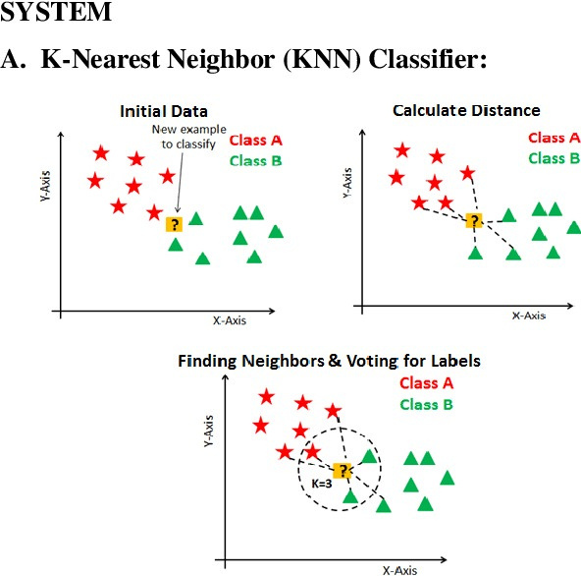
SMOTE Function
Smote function focus on the minority and pick a random sample from it as a seed sample. Then, it uses K-NN algorithm to find the k closest sample from the seed sample. Then, it generates a Synthetic Sample by selecting a random neighbor and generate a new sample along the line segment between the seed and the neighbor.

Slide 11
DATA
MODELING
05
In that project we applied 3 models and determine the best one depending on their statistics.

Slide 12

Random forest
A tree-based ensemble learning algorithm that builds
multiple decision trees during training and combines their outputs to improve classification performance.
It is particularly useful for feature importance analysis, providing insights into which features contribute most to anomaly detection.

Slide 13
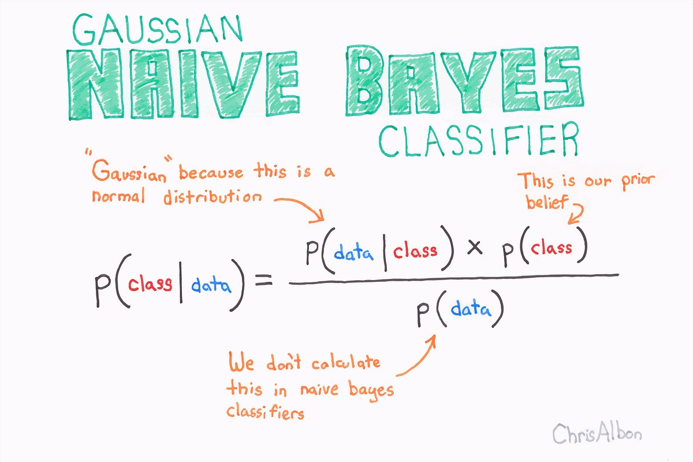
Naive Bayes
A probabilistic classification model based on Bayes'
Theorem, assuming independence between features.
It works well with smaller datasets and handles imbalanced data efficiently by calculating probabilities directly.

Slide 14
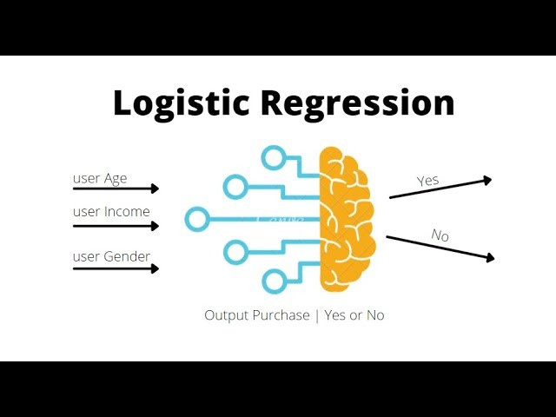
logistic regression
A linear model that predicts probabilities for binary
classification problems.
It is well-suited for datasets where the relationship between features and the target is approximately linear.

Slide 15
RESULTS
06
The models are evaluated using the following metrics:
1- Accuracy
2- Precision
3- Recall
4- F1-Score
5- Confusion Matrix

Slide 16
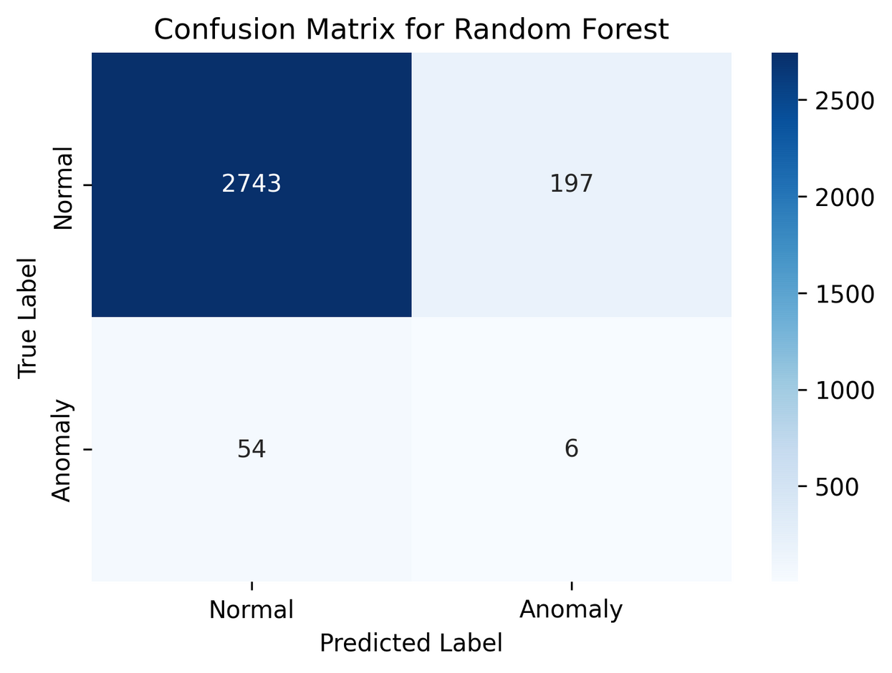
A
Random Forest
Random forest represented accuracy 91.63% and f1-score 0.0456

Slide 17
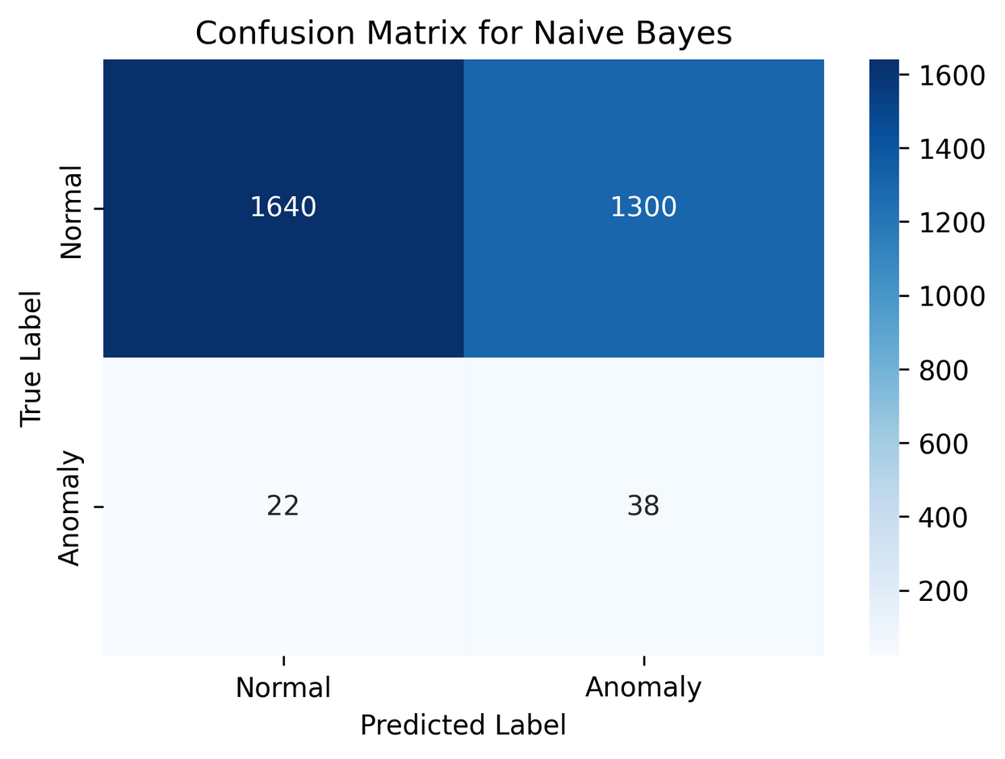
A
Naive Bayes
Naive Bayes model represented accuracy 55.93% and f1-score 0.0544.

Slide 18
A
Logistic Regression
Logistic Regression model represented accuracy 55.73% and f1-score 0.0473.

Slide 19
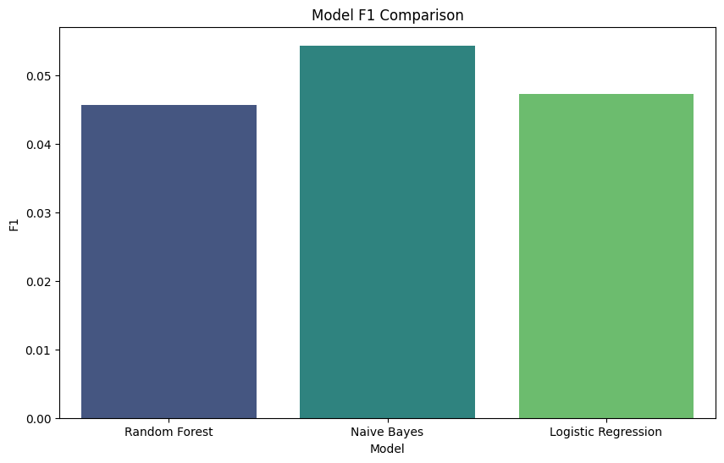
A
F1-Score Comparison
depending on F1-score the best model is Naive Bayes model with score 0.0544.

Slide 20
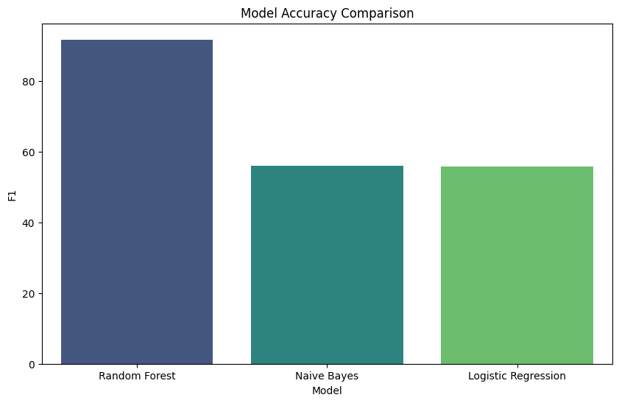
A
Accuracy Comparison
depending on the accuracy the best model is Random Forest model with accuracy 91.63%

Slide 21

THANK YOU

